Slide 1
SQL Notebooks in Azure Data Studio
for the DBA
Rob Sewell - Sewells Consulting Ltd

Slide 4

Rob Sewell
Bearded Consultant, Automator,
Trainer
Consultant Sewells Consulting Ltd
beard.media/book dbachecks PowerShell & Data Community
/robsewellsqldba
@sqldbawithbeard
SQLDBAWithABeard.com

Slide 5
What’s Azure Data Studio?

Slide 6
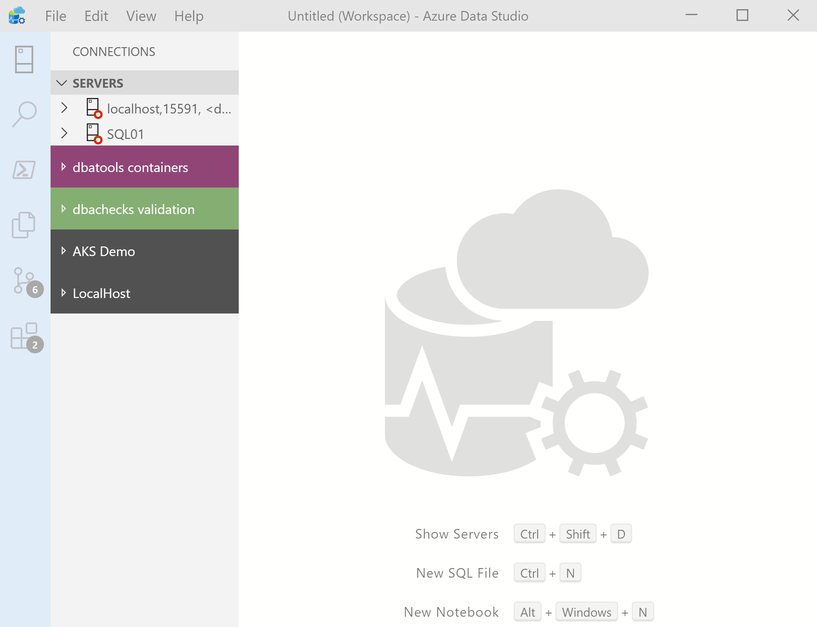
What’s Azure Data Studio ?
Cross Platform desktop environment for Data Professionals

Slide 7

So it’s only for Azure?

Slide 8
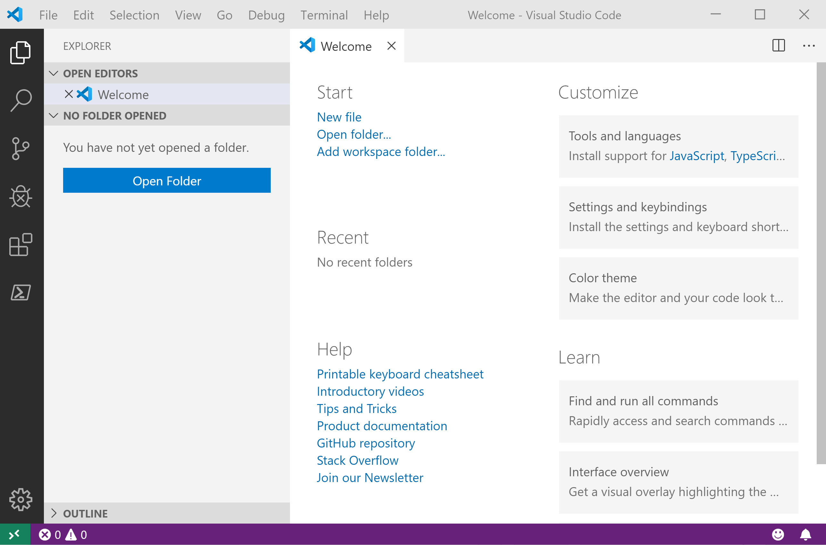
It Looks Like Visual Studio Code ?

Slide 9
It Looks Like Visual Studio Code ?

Slide 10
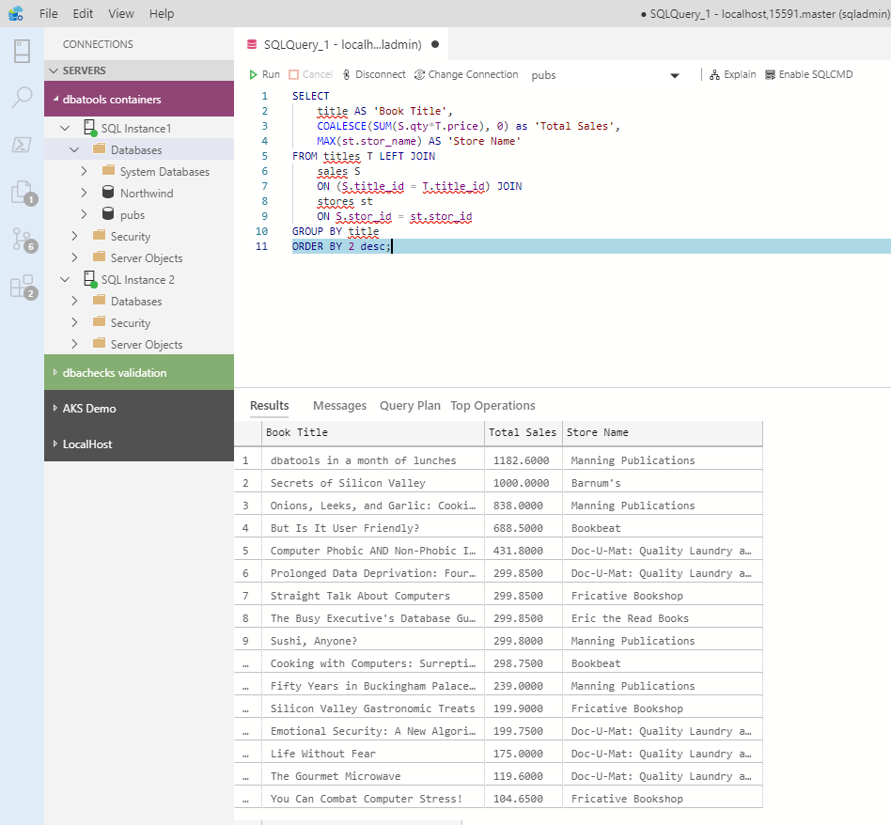
What can you do in Azure Data Studio ?
You can run T-SQL queries!

Slide 11
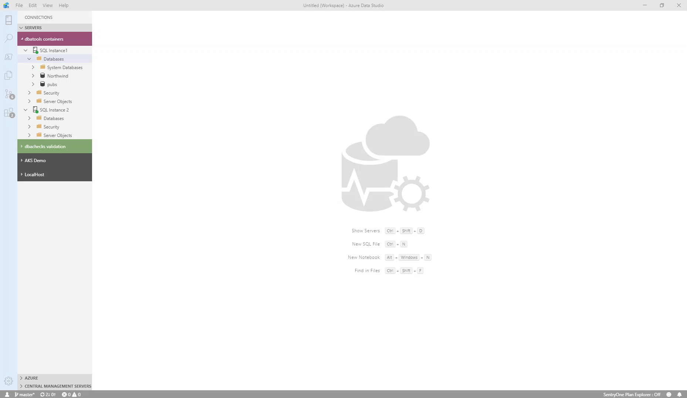
What can you do in Azure Data Studio ?
You can get execution plans

Slide 12
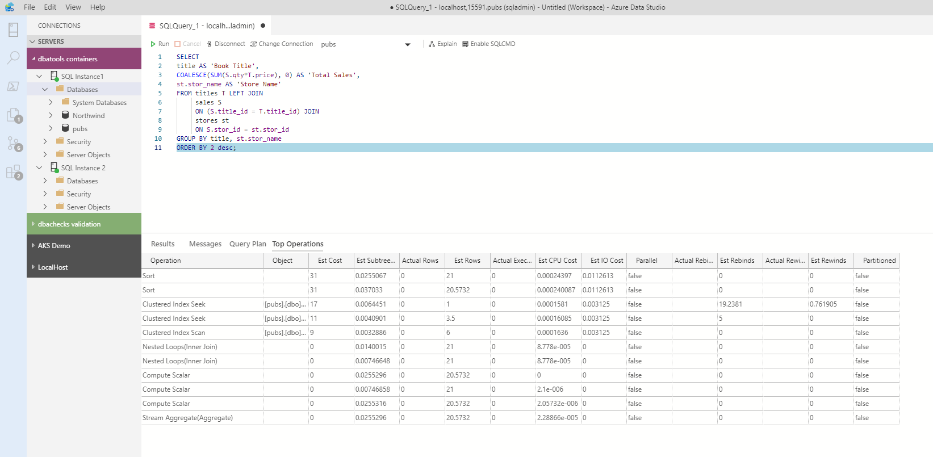
What can you do in Azure Data Studio ?
You can get the top operations

Slide 13
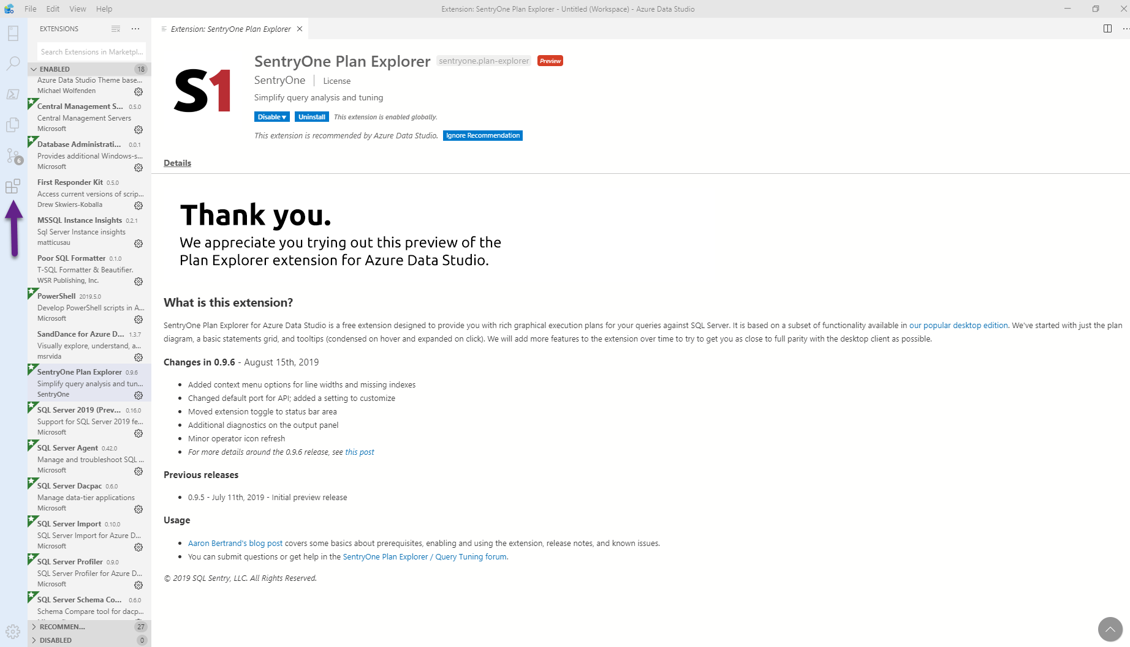
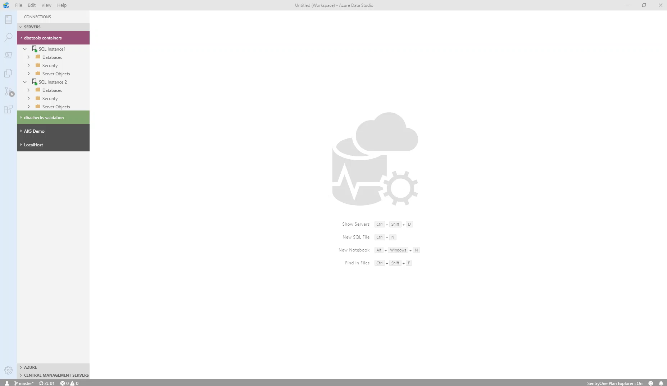
What can you do in Azure Data Studio ?
You can install extensions for more functionality

Slide 14
What can you do in Azure Data Studio ?
And get Plan Explorer

Slide 15
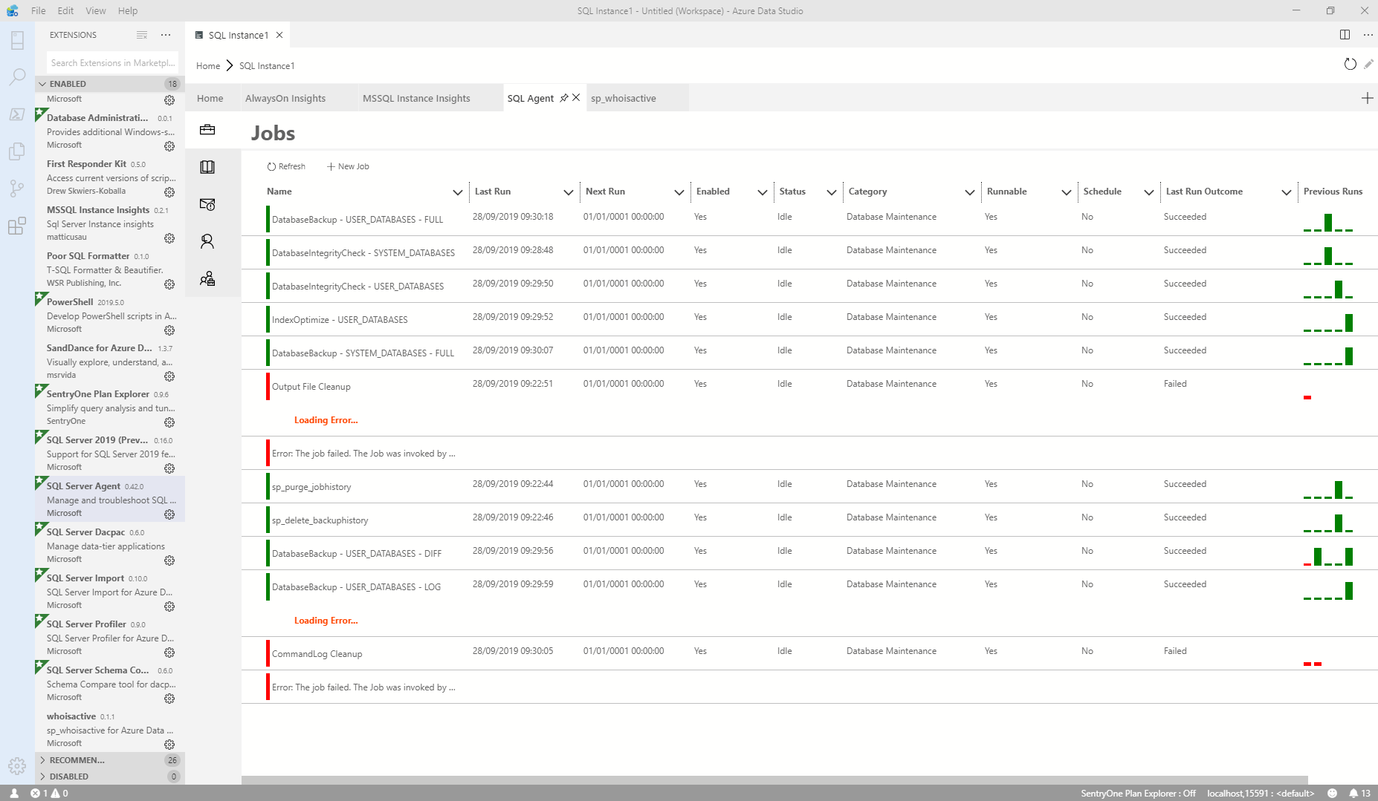
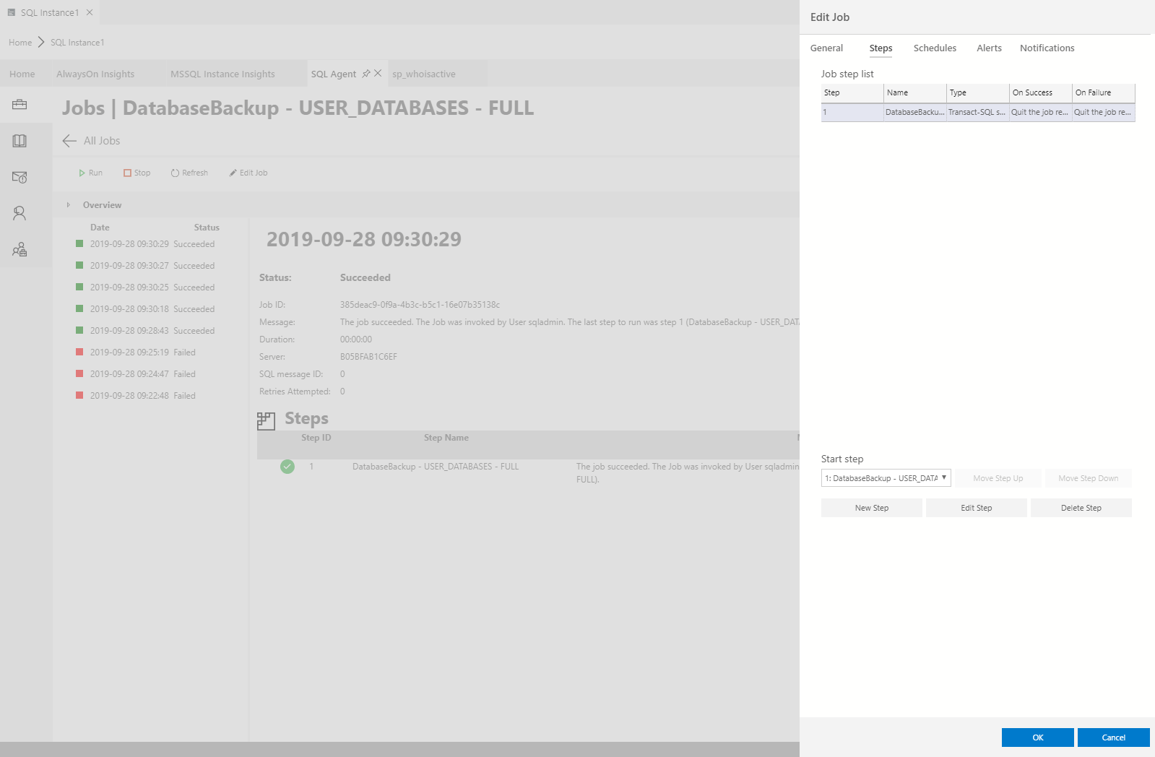
What can you do in Azure Data Studio ?
You can work with SQL Agent Jobs

Slide 16
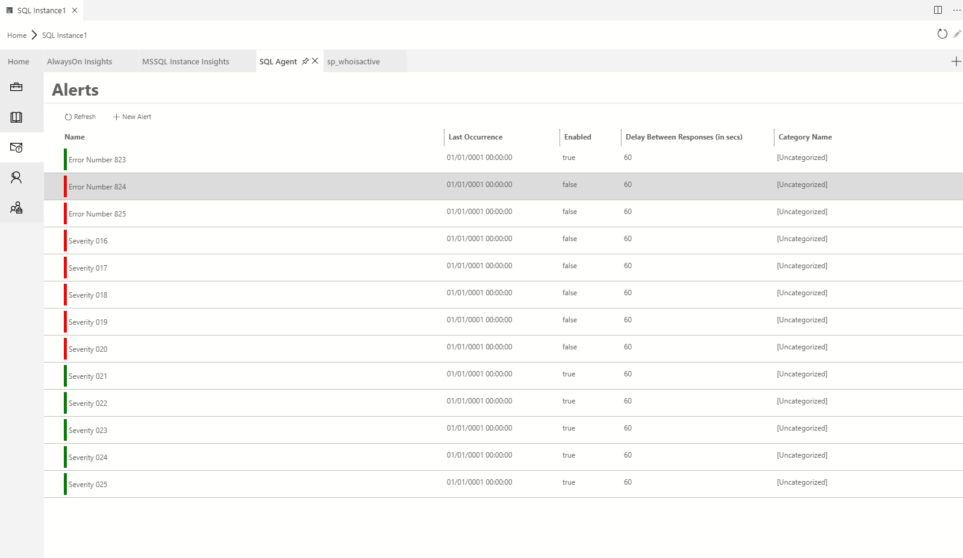
What can you do in Azure Data Studio ?
You can work with SQL Agent Jobs

Slide 17
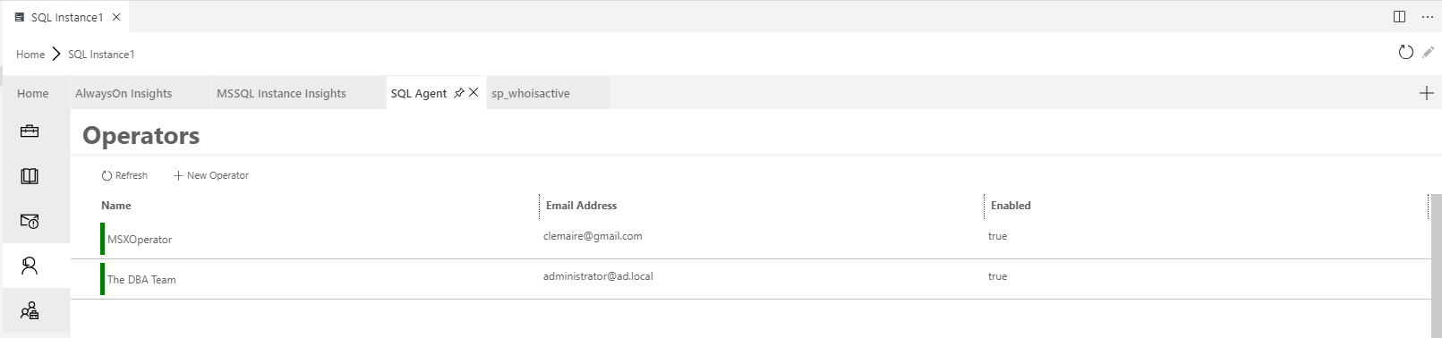
What can you do in Azure Data Studio ?
You can work with Alerts

Slide 18
What can you do in Azure Data Studio ?
You can work with Operators

Slide 19
What can you do in Azure Data Studio ?

Slide 20

What can you do in Azure Data Studio ?

Slide 21
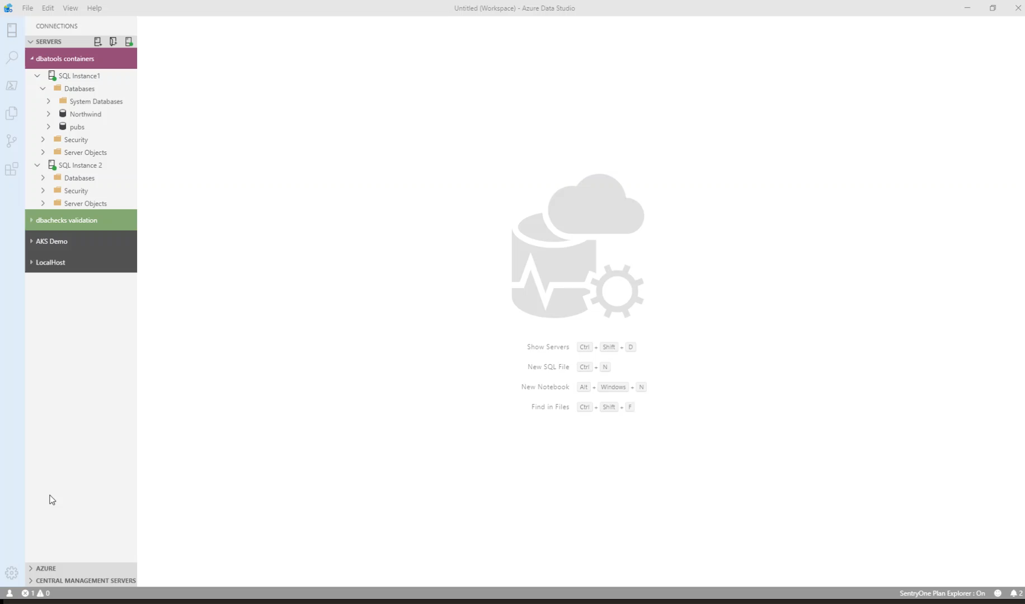
What can you do in Azure Data Studio ?
You can run PowerShell ☺

Slide 22
What’s A SQL Notebook?

Slide 23

What is a SQL Notebook?
Originally for Data Scientists

Slide 24
What is a SQL Notebook?
Document that can contain text, code, images and query results

Slide 25
I’m a DBA

Slide 26
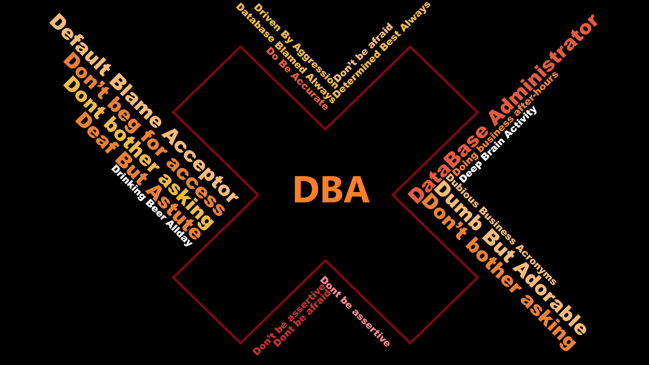

Slide 27

Let Your Mind Run Free
Photo by Alice Donovan Rouse on Unsplash

Slide 28
Some Ideas
Run Books
Training
Incident response templates – for Service Desk and for DBAs
Templates for common functions
Demoing
Share Data with a 3rd Party

Slide 30
Rob Sewell
@SQLDBAWithBeard
mrrobsewell@outlook.com
beard.media/book

